Slide 1
Flower Recognition
Name: Chih-Che Fang
Student No: 90799210Y
Data: 2019/6/19

Slide 2
Agenda
Research Motivation
Problem Description
Data Preprocessing
Methodology
Model Training
Performance Evaluation
Reference
Summary / Q&A

Slide 3
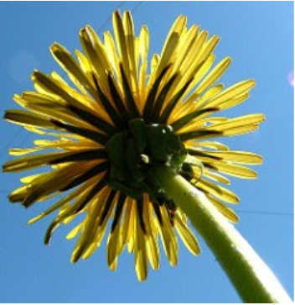
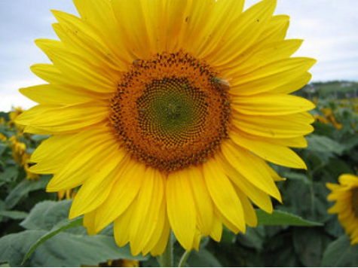
Research Motivation
Problem:
Flower classification subject to subjective judgement
Sometimes involved with human errors
Goal: Provide a reliable index for taxonomist
Dandelion
Sun Flower
Sun Flower
Or
Dandelion??

Slide 4
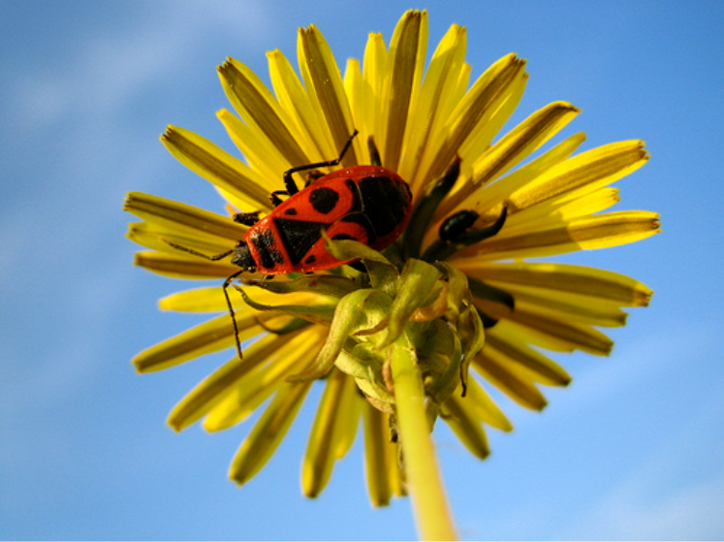
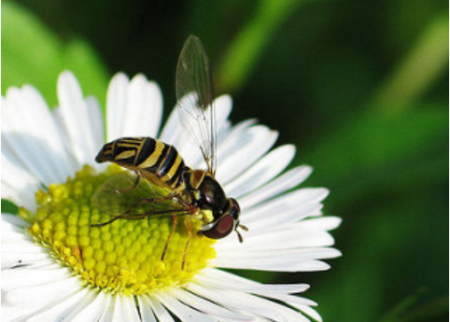

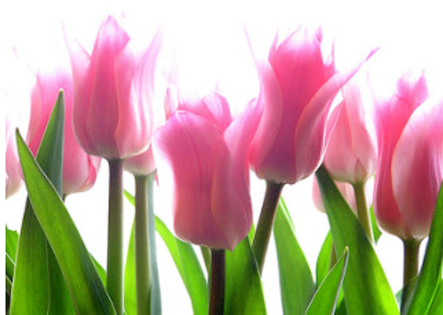
Problem Description
Daisy
Dandelion
Rose
Sun Flower
Tulip

Slide 5
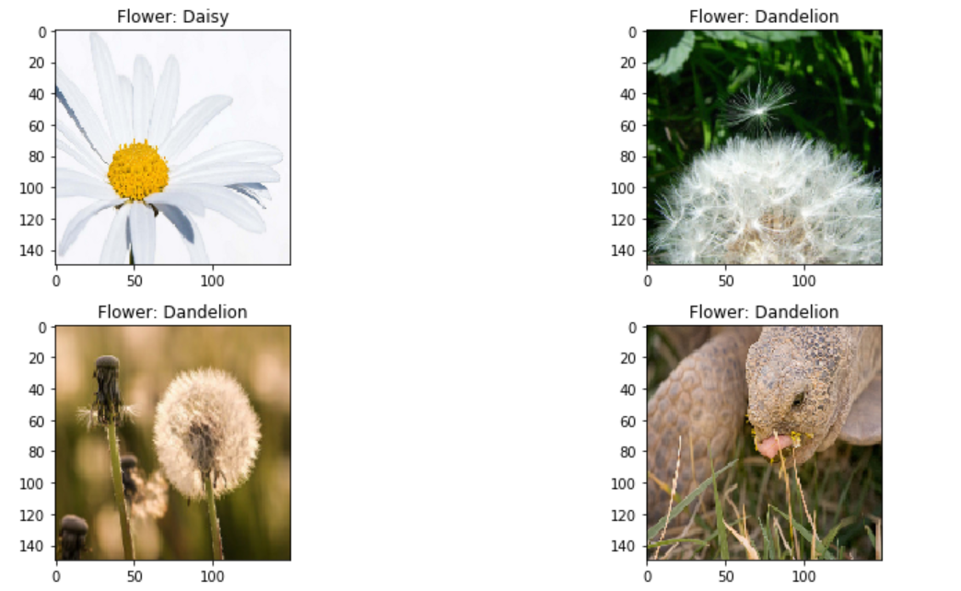
Data Preprocessing – Image Reading
Data Format: 4242 JPG Image
Processed Image
Data Reading:
RGB | RGB | RGB
RGB | RGB | RGB
RGB | RGB | RGB
RGB | RGB | RGB
img = cv2.imread(path,cv2.IMREAD_COLOR)
img = cv2.resize(img, (150,150))
img = cv2.cvtColor(img, cv2.COLOR_BGR2RGB)
X.append(np.array(img))
X /= 255
Array Size(150*150*3)
Visualizing Image:
fig, ax=plt.subplots(5,2)
ax[i , j].imshow(X[l])

Slide 6
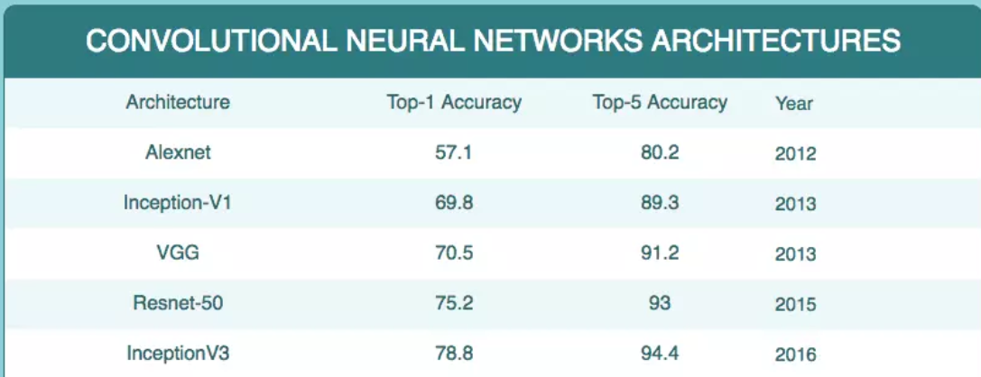
Methodology
Transfer-Learning
VGG16
ResNet-50
Build From Scratch
8 Conv Layer + 2 Fully-Connected Layer CNN

Slide 7
Model Training – Development Environment
Backend: Tensorflow – GPU V1.13.1 + CUDA V10 with CUDNN V10
Language & Framework: Python3.7 + Keras-GPU
IDE: Jupyter Notebook
GPU: Gforce 940MX (Notebook)

Slide 8
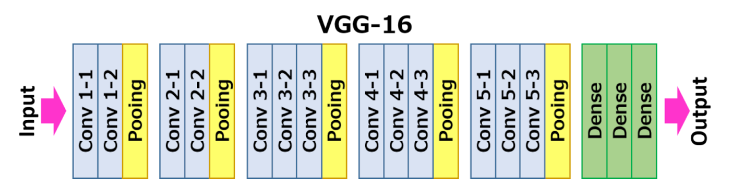
Model Training - Transfer Learning Model
Architecture: CNN - VGG16 + 2 Fully Connected Layer
VGG16
Output
Neuron:
5
Function:
Sigmoid
Hidden
Neuorn: 512
Function:
ReLU
150 * 150 *3
Flatten
Reference: https://www.kaggle.com/rajmehra03/a-comprehensive-guide-to-transfer-learning

Slide 9
Model Training - Transfer Learning Model
Model: VGG 16 (19 Conv Layer)
UnBlocked Layer | Hidden Layer Neurons | Accuracy | Loss
11-19 | 512 | 0.9006 | 0.4703
11-19 | 256 | 0.8217 | 0.5018
15-19 | 512 | 0.875 | 0.4901
15-19 | 256 | 0.8052 | 0.5240
None-Block | 256 | 0.7674 | 0.6042
Reference: https://www.kaggle.com/rajmehra03/a-comprehensive-guide-to-transfer-learning

Slide 10
Model Training - Transfer Learning Model
Model: VGG 16 (19 Conv Layer)
Unblocked Layer | Hidden Layer Neurons | Pooling | Accuracy | Loss
11-19 | 512 | Max | 0.9156 | 0.4360
11-19 | 512 | Avg | 0.9006 | 0.4703

Slide 11
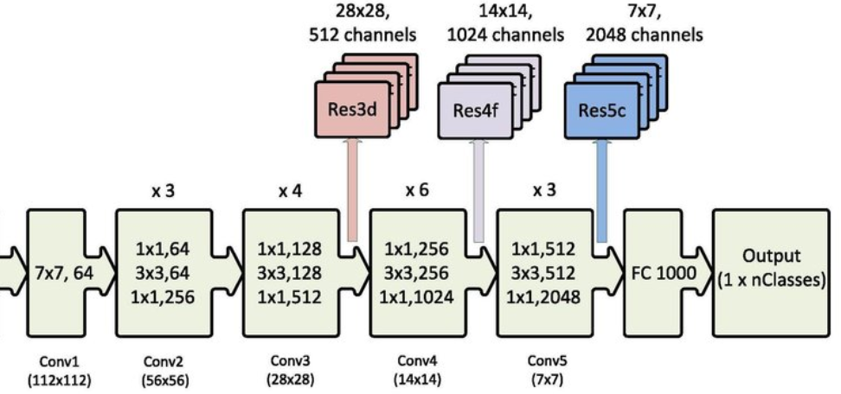
Model Training - Transfer Learning Model
Architecture: CNN – ResNet50 + 2 Fully Connected Layer
ResNet50
Output
Neuron:
5
Function:
Sigmoid
Hidden
Neuorn: 1000
Function:
ReLU
150 * 150 *3
Flatten
Reference: https://www.kaggle.com/rajmehra03/a-comprehensive-guide-to-transfer-learning

Slide 12
Model Training - Transfer Learning Model
Model: ResNet50 (175 Conv Layer)
UnBlocked Layer | Hidden Layer Neurons | Accuracy | Loss
Unblock all | 1000 | 0.895 | 0.4301
1 - 175 | 1000 | 0.885 | 0.4503
3-175 | 1000 | 0.885 | 0.4803
50-175 | 512 | 0.8717 | 0.4817
100-175 | 512 | 0.8753 | 0.4901
115-175 | 512 | 0.8652 | 0.6240
Block all | 512 | 0.8074 | 0.6442
Reference: https://www.kaggle.com/rajmehra03/a-comprehensive-guide-to-transfer-learning

Slide 13
Model Training - Transfer Learning Model
Model: ResNet50 (175 Conv Layer)
UnBlocked Layer | Hidden Layer Neurons | Pooling | Accuracy | Loss
UnBlock all | 1000 | Avg | 0.9147 | 0.4303
UnBlock all | 1000 | max | 0.895 | 0.4301

Slide 14
Model Training - Build From Scratch
Neural Network: CNN
Architecture: 8 Convolution Layer
Conv
Filter: 96
Kernel: 3*3
Function:
ReLU
Conv
Filter: 64
Kernel: 3*3
Function:
ReLU
Pooling:
2*2
Function:
ReLU
Pooling:
2*2
Function:
ReLU
Pooling:
2*2
Function:
ReLU
Conv
Filter: 32
Kernel: 2*2
Function:
ReLU
Conv
Filter: 96
Kernel: 3*3
Function:
ReLU
Pooling:
2*2
Function:
ReLU
150 * 150 *3
Reference: https://www.kaggle.com/rajmehra03/a-comprehensive-guide-to-transfer-learning

Slide 15
Model Training – Build-From-Scratch Model
Neural Network: CNN
Architecture: 2 Hidden/Output Layer
Five types of flowers
Hidden
Neuorn: 512
Function:
ReLU
Output
Neuron:
5
Function:
Sigmoid
Flatten
Reference: https://www.kaggle.com/rajmehra03/a-comprehensive-guide-to-transfer-learning

Slide 16
Model Training – Parameter Search
Method: Hyperparameter Tuning
Purpose: Finding the right hyperparameters for your deep learning model
Hyperparameter Optimization for Keras
DeepReplay — Hyperparameter Visualization
Hyperas — Keras Wrapper for Hyperopt
Kopt — Another Hyperopt Based Optimizer
Talos — Hyperparameter Optimization for Keras

Slide 17
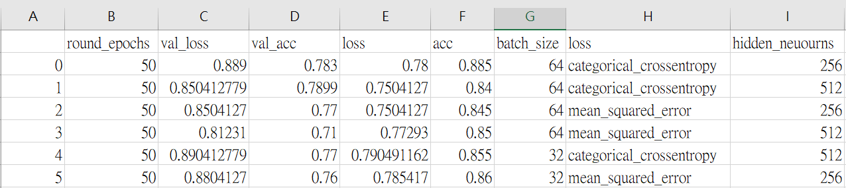
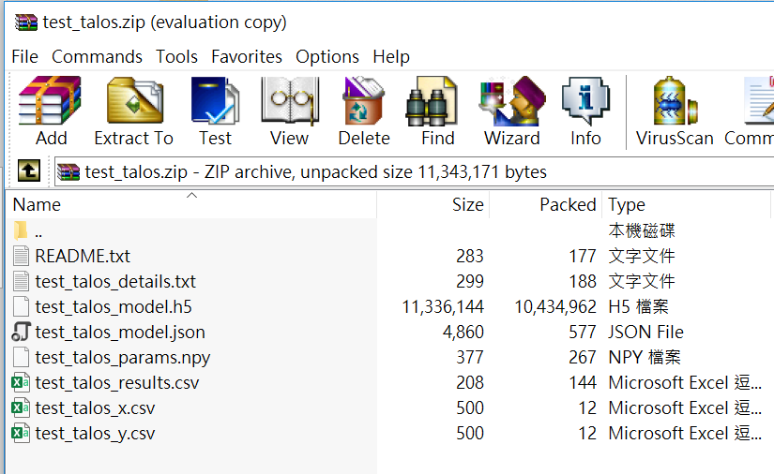
Model Training – Hyperparameter Tuning
1. Define Hyperparameter
4. Save Reports/Models
p = {
'batch_size': [32, 64]
'loss' : ['categorical_crossentropy', 'mean_squared_error']
'hidden_neuourns' : [256, 512]
}
ta.Deploy(t, 'test_talos');
2. Running Hyperparameter Algorithm:
t = ta.Scan(x_train, y_train, p, create_model)
3. Evaluate Models
e.evaluate(x_test, y_test, folds=10)

Slide 18
Model Training – Choosing Loss Function and minBatch
Loss Function: (For Classification Problem)
1.Catorical Cross-Entropy => Faster Convergence (69 epoch -> 50 epoch)
2.MSE(Mean Square Error)
Min-Batch: Decrease the probability of stopping at local optimal
Size: 32 64 128 256
GPU Memory Limit

Slide 19
Model Training – Gradient Vanishing/Exploding/Underfitting
ReLu function
Learning Rate
Batch Normalization
Accuracy decreased from 0.783 ->
0.751 in build in build-from-scratch
Methods
Convolution
Hidden Layer
Batch Normalization
Batch Normalization
Pooling
Output

Slide 20
Model Training - Overfitting
Data Augmentation
Early Stopping
Dropout
Accuracy decreased from 0.783 ->
0.721 in build in build-from-scratch
Methods

Slide 21
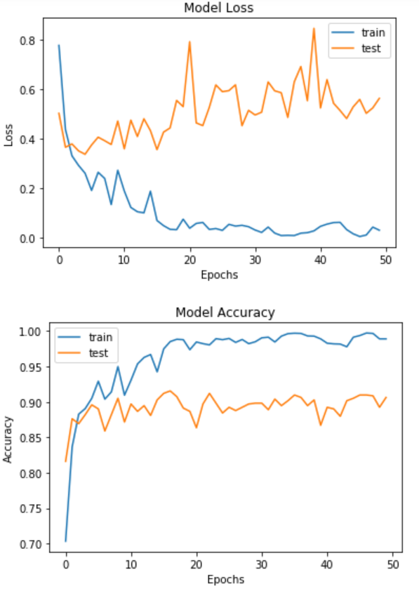
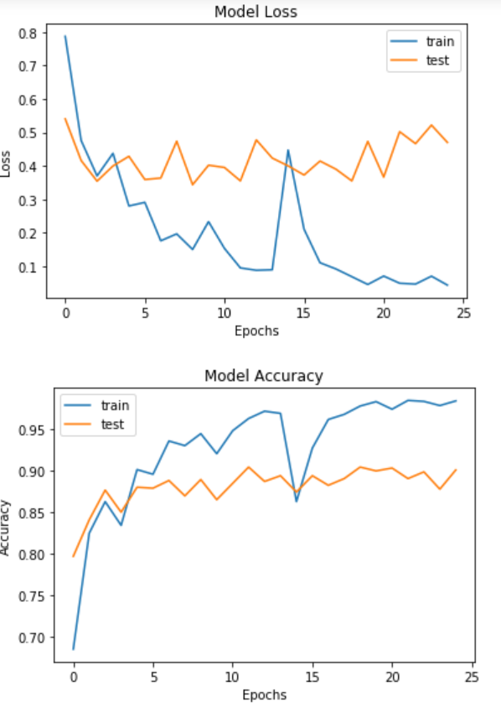
Model Training - Overfitting
Method: Early Sopping

Slide 22
Model Training - Overfitting
Method: Data Augmentation
Purpose: Prevent Overfitting
Description: Randomly create “Fake” image via processing original image (Rotate, Change Image Size/Ratio, Change brightness and Color Temperature….) to compensate the deficiency of data
Implementation: Keras ImageGenerator

Slide 23
Model Training - Overfitting
Mehtod: Data Augmentation
datagen = ImageDataGenerator(
featurewise_center=False, # set input mean to 0 over the dataset
samplewise_center=False, # set each sample mean to 0
featurewise_std_normalization=False, # divide inputs by std of the dataset
samplewise_std_normalization=False, # divide each input by its std
zca_whitening=False, # apply ZCA whitening
rotation_range=10, # randomly rotate images in the range (degrees, 0 to 180)
zoom_range = 0.1, # Randomly zoom image
width_shift_range=0.2, # randomly shift images horizontally (fraction of total width)
height_shift_range=0.2, # randomly shift images vertically (fraction of total height)
horizontal_flip=True, # randomly flip images
vertical_flip=False) # randomly flip images
Don‘t set too large parameter

Slide 24
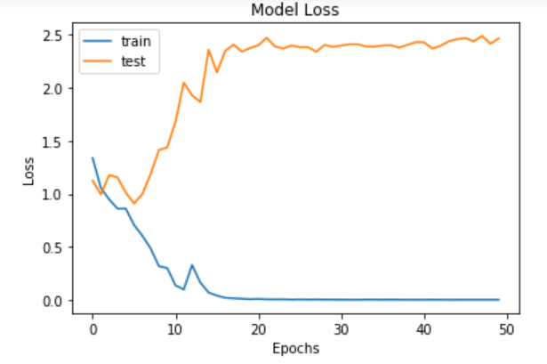
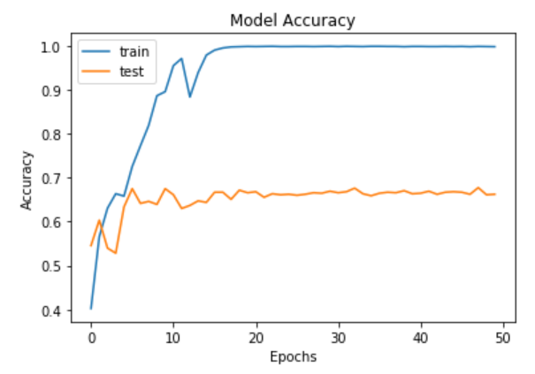
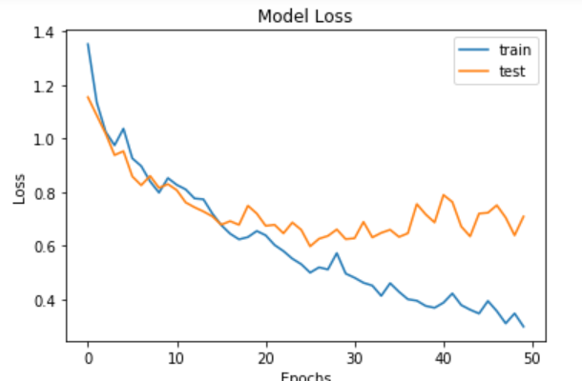
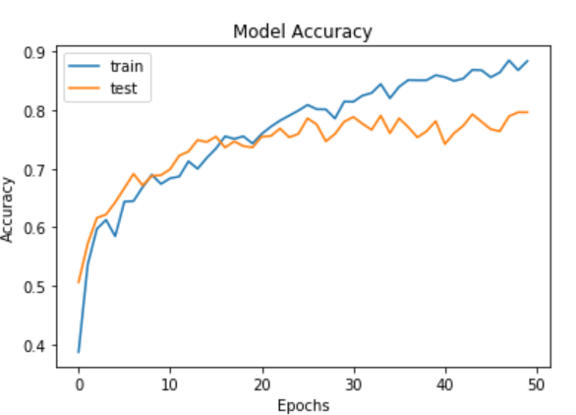
Model Training - Overfitting
Without Data Augmentation
With Data Augmentation

Slide 25
Model Training - Heuristic Improvement
Learning Rate Annealing:
No significant improvement
red_lr= ReduceLROnPlateau(monitor='val_acc',patience=3,verbose=1,factor=0.1)

Slide 26
Performance Evaluation – Loss/Accuracy
Comparison (849 testing image)
 | Epoch | Accuracy | Loss
Best Model (ResNet34) | 6 | 0.933 | 0.19
Transfer Learning (VGG16, MAX pooling) | 25 | 0.9156 | 0.4360
Transfer Learning (ResNet50, Avg pooling) | 13 | 0.9147 | 0.4303
Build-From Scratch (CNN) | 50 | 0.783 | 0.889

Slide 27
Performance Evaluation – Loss/Accuracy
Comparison (849 testing image) => Increase Resolution from 150*150 -> 200*200
 | Epoch | Accuracy | Loss | Resolution
Transfer Learning (ResNet50, Avg pooling) | 5 | 0.9341 | 0.2328 | 200*200
Best Model (ResNet34) | 6 | 0.933 | 0.19 | ?
Transfer Learning (VGG16, MAX pooling) | 25 | 0.9199 | 0.3360 | 200*200
Build-From Scratch (CNN) | 50 | 0.783 | 0.889 | 150*150

Slide 28
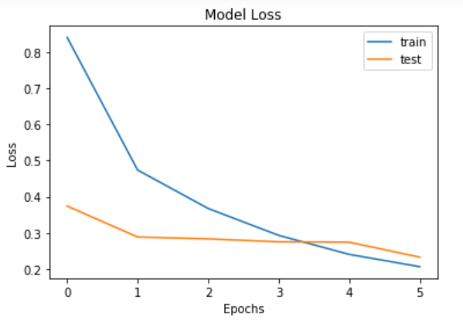
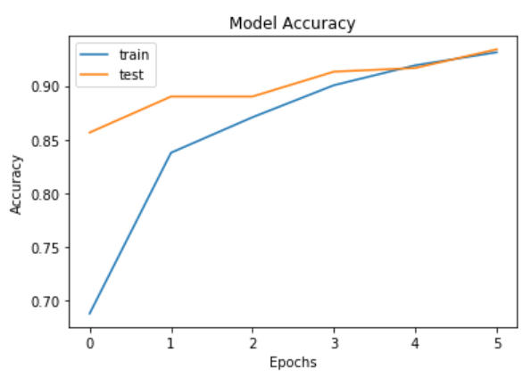
Performance Evaluation – Loss/Accuracy
Build-From Scratch
Transfer Learning
Win!

Slide 29
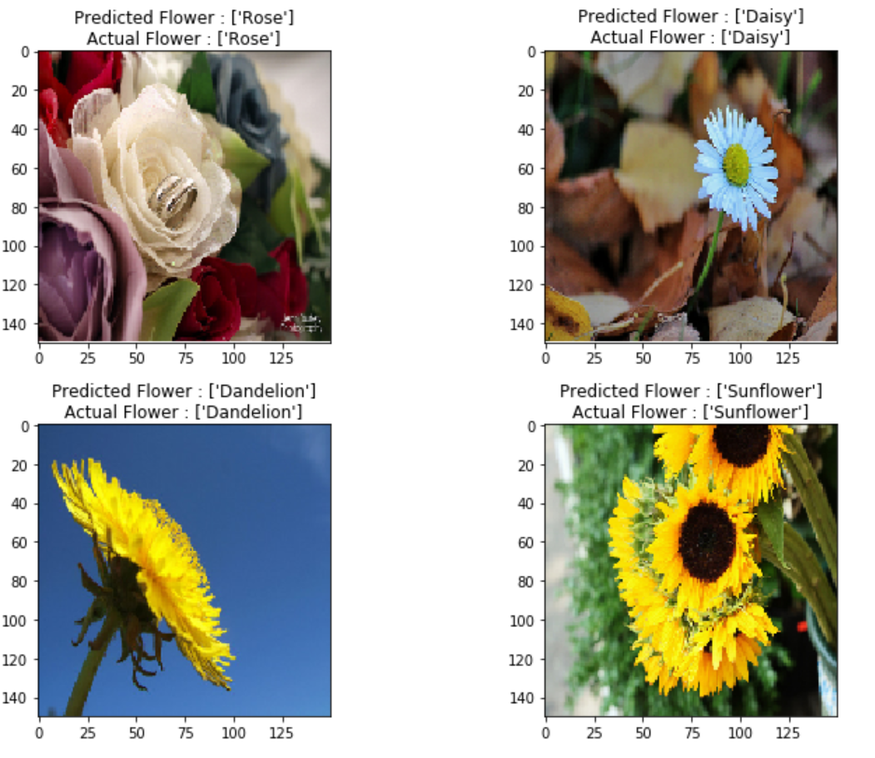
Performance Evaluation - Visualizing Predictions
CORRECTLY CLASSIFIED FLOWER IMAGES

Slide 30
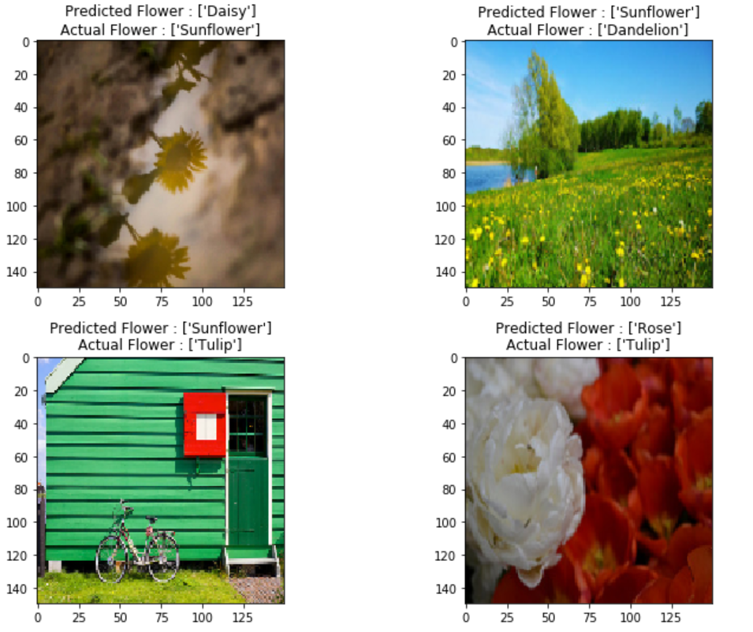
Performance Evaluation - Visualizing Predictions
MISCLASSIFIED IMAGES OF FLOWERS

Slide 31
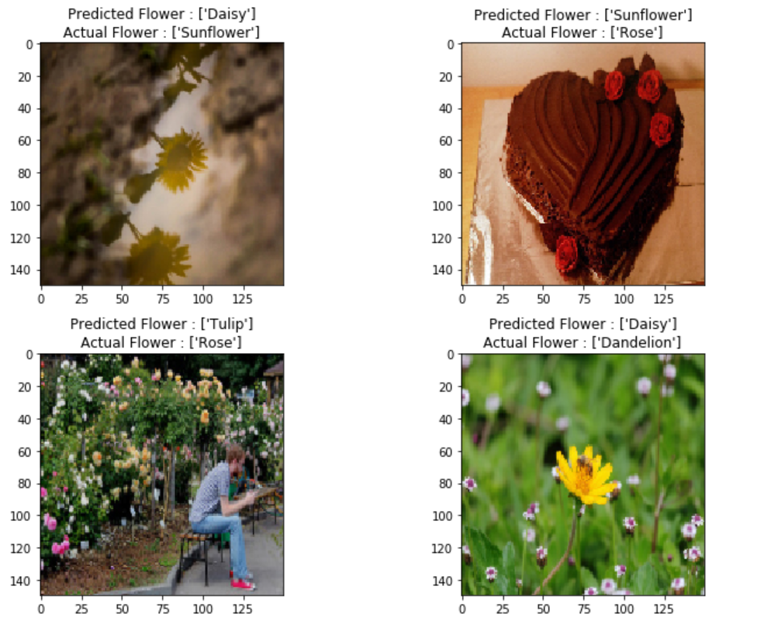
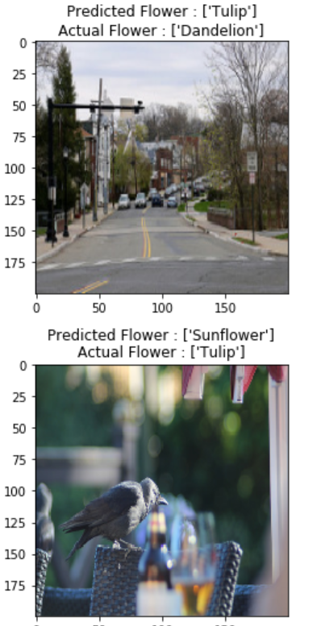
Performance Evaluation - Visualizing Predictions
MISCLASSIFIED IMAGES OF FLOWERS

Slide 32
Reference (1/2)
Flower Recognition CNN Keras - https://www.kaggle.com/rajmehra03/flower-recognition-cnn-keras
Data Augmentation - https://chtseng.wordpress.com/2017/11/11/data-augmentation-%E8%B3%87%E6%96%99%E5%A2%9E%E5%BC%B7/
Deep Learning Rules - https://medium.com/@intheblackworld/deep-learning-tutorial-%E5%BF%83%E5%BE%97-b1f7f84a497d
Min-Batch - https://blog.csdn.net/xiang_freedom/article/details/78395145
ResNet50 - https://blog.gtwang.org/programming/keras-resnet-50-pre-trained-model-build-dogs-cats-image-classification-system/

Slide 33
Reference (2/2)
Cross-Entropy - https://zhuanlan.zhihu.com/p/26268559
Dropout Technique - https://kknews.cc/zh-tw/tech/9ymxpq.html
CNN Batch Normalization - https://www.kaggle.com/achukka/conv-layers-with-batch-normalization-in-keras
Hyperparameter Tuning - https://github.com/maxpumperla/hyperas
Transfer Learning - https://www.kaggle.com/sominwadhwa/flower-recognition-fastai-94-accuracy

Slide 34

Summary / Q&A
Transfer learning outperforms build-from-scratch methods
Use hyperparameter tuning tools to speed up model building process
Using complex model or fancy technique does not necessarily mean better performance
May use parallel computing systems to speed up training process
For misclassification of small flower, may use another NN to pre-recognize small flower.
Thank You for listening

Slide 35
BackUp

Slide 36
Methodology - Transfer Learning
Steps:
1. Load pretrained model and weights
2. Block/Un-block weight
3. Add your fully-connected neural network
4. Hyperparameter tuning
5. Train the model & Handle Overfitting/Gradient Vanishing
6. Performance Emulation

Slide 37
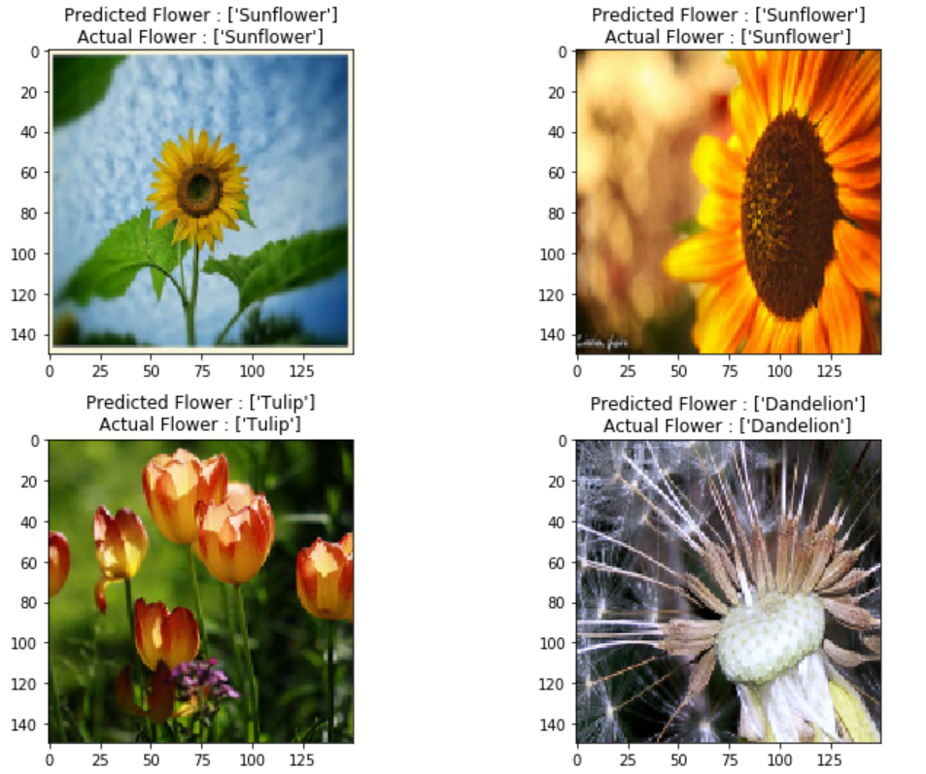
Performance Evaluation - Visualizing Predictions
CORRECTLY CLASSIFIED FLOWER IMAGES

Slide 38
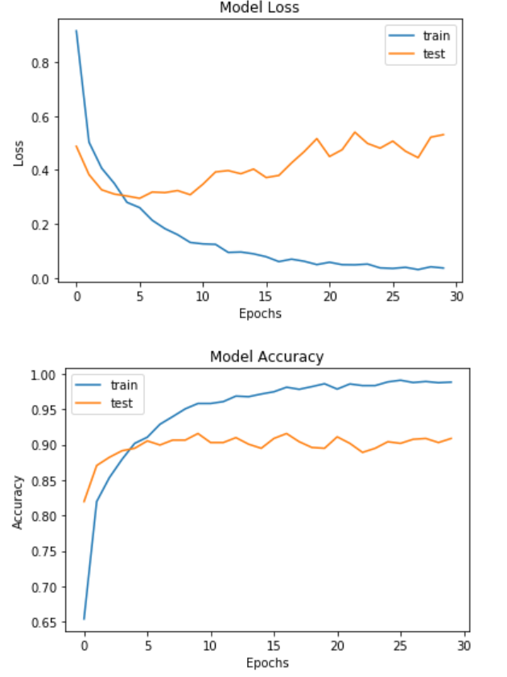
ResNet50 bad result
Accuracy: 0.9087
Loss:0.5312

